Slide 1
Pager Rotation Duties
Kimberly Orozco
CSD380-T301 DevOps
October 24, 2025

Slide 2
Why on-call matters in DevOps
DevOps teams share responsibility for both building and running software. This means they also respond to problems when they happen. On-call duties are part of that shared responsibility and help teams catch and fix issues quickly. In Chapter 16 of our book, it mentions that when they woke up developers at 2AM, the issues they had were fixed quicker than before.
How is this helpful?
Helps keeps services running constantly.
Encourages ownership.
Builds teamwork.

Slide 3
Best Practices
Having a good on-call rotation means more than just taking turns though. It need structure and communication to make everything go smoothly.
What are some best practices?
Setting CLEAR team roles and responsibility.
Keep updated documentation available.
Review incidents after they happen to learn from them.
These steps support collaboration and make it easier to manage systems together.

Slide 4
Scheduling Models and Fairness
The way teams schedule on-call shifts can affect how well people work and how much stress they feel. This is a system that is ESSENTIAL on fairness. Good scheduling helps balance workloads and prevents burnout.
Tips for better schedulingL
Rotate fairly so everyone shares an even workload.
Use a “follow the sun” model for global teams (FireHydrant, 2024)
Give developers a say in schedule planning.
In DevOps it’s important to keep fairness and communication as key components in team building. Scheduling should be a reflection of that.

Slide 5
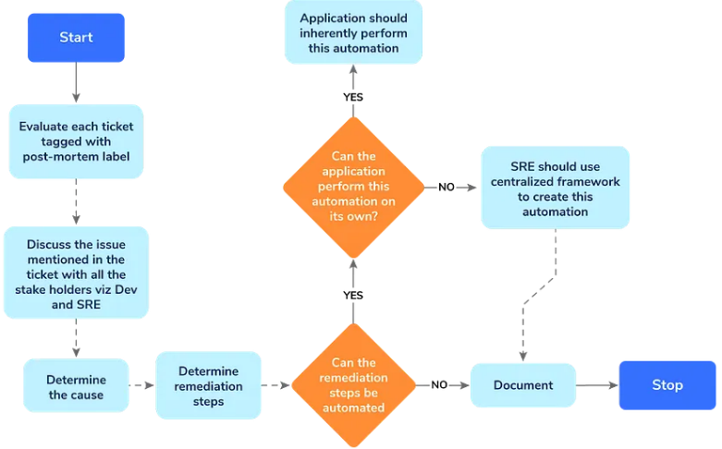
Handoffs and Post-Mortems
Good communication during shift changes prevents confusion. Teams should also review incidents after they are fixed to learn what went wrong and how to prevent it. Even if they weren’t the one responsible for it, they should still be aware of what happened.
Best Practices:
CLEAR handoff notes about current issues.
Have post-mortem meetings to go over any issues.
Focus on learning, not placing any blame.
Figure 2, Medium, “Post-Mortem Analysis.”

Slide 6
Communication and Collaboration
Good communication is one of the most important parts of a strong on-call rotation. In DevOps, teamwork between developers helps fix problems fast and keep systems running smoothly.
Best practices:
Send alerts to the right people and channels.
Keep EVERYONE updated during an incident.
Encourage honest and open communication.
Write clear notes after any issues so others can learn from them.

Slide 7
Preventing Burnout
On-call work is stressful, so it’s important to keep track how it affects people and make improvements when needed. All the sources listed at the end of the presentation explain how vital it is to preventing burnout. This is something that is very detrimental in on-call work.
Ways to reduce burnout:
Limit overnight shifts when possible.
Give time off after tough shifts.
Rotate duties fairly.
Watch for alert fatigue.

Slide 8
Quick checklist!
In order to create a strong on-call rotation teams need to plan carefully and, more importantly, connect everything to the project they are working on.
Checklist:
Set up rotation schedules and backups in advance.
Create rules.
Automate alerts and monitoring.
Track performance and stress levels.
Hold post-mortem meeting and share problems/lessons learned.

Slide 9
Works Cited
Best practices for your team’s on-call rotations. Cortex. (n.d.). https://www.cortex.io/post/best-practices-for-on-call-rotations
On-call rotations and schedules. PagerDuty. (2025, September 4). https://www.pagerduty.com/resources/incident-management- response/learn/call-rotations-schedules/
Squadcast. (2025, February 27). On-call rotation: A complete guide to best practices. Medium. https://medium.com/@squadcast/on-call-rotation-a-complete-guide- to-best-practices-997b0da54499
Team, F. (2025, August 21). Best practices for creating on-call rotations and schedules. https://firehydrant.com/blog/best-practices-for-creating-on-call-rotations-and-schedules/

